Slide 1
Raspberry Pi
An Introduction
Wes Colemere

Slide 2
What is a Raspberry Pi
A Raspberry Pi is:
A cute little computer.
A platform for learning programming and embedded systems.
Not an actual pie.
A fun way to learn Linux.
An accessible way to learn about ARM processors.
A cheap* little computer.
*Raspberry Pis are not usually that cheap nowadays—or readily available.

Slide 3
Why Do People Like Them?

Slide 4
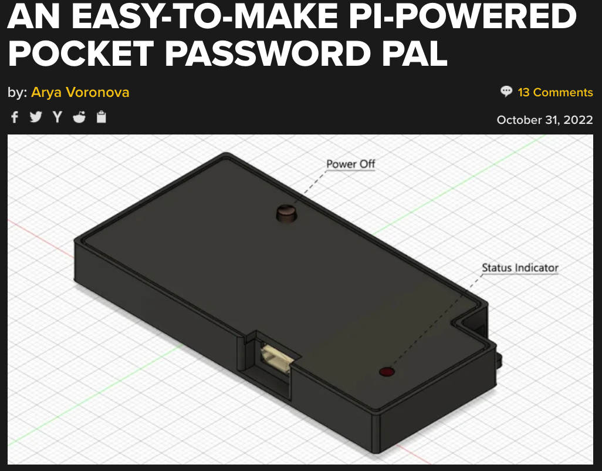
https://hackaday.com/2022/10/31/an-easy-to-make-pi-powered-pocket-password-pal/

Slide 5
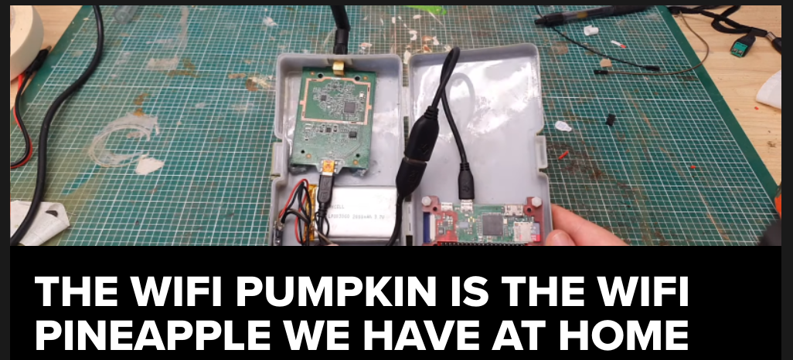
https://hackaday.com/2022/10/27/the-wifi-pumpkin-is-the-wifi-pineapple-we-have-at-home/

Slide 6
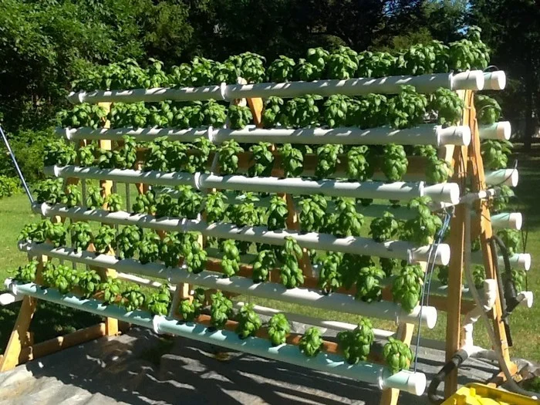
https://www.instructables.com/DIY-Hydroponics-With-Raspberry-Pi/

Slide 7
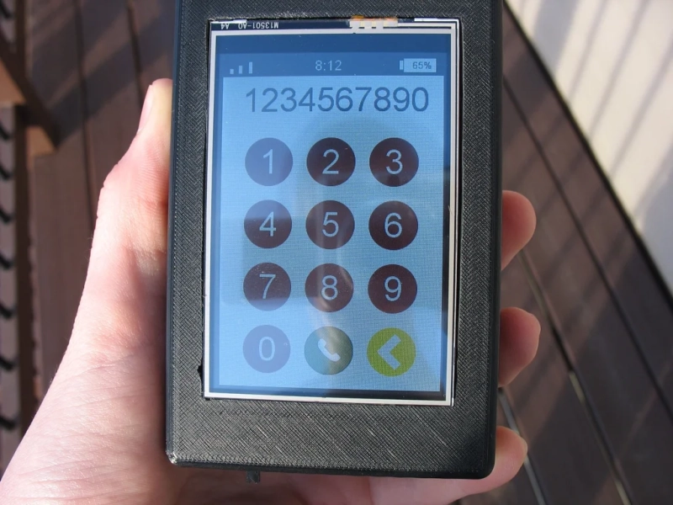
https://hackaday.com/2022/10/10/a-raspberry-pi-phone-for-the-modern-era/

Slide 8
WOW!

Slide 9
“Never say 'no' to pie. No matter what, wherever you are, diet-wise or whatever, you know what? You can always have a small piece of pie, and I like pie. I don't know anybody who doesn't like pie. If somebody doesn't like pie, I don't trust them. I'll bet you Vladimir Putin doesn't like pie.”
—Al Roker

Slide 10
Let’s Look At One
Pi
Who doesn’t like pi

Slide 11
Now What?
Here’s some potential next steps if you are looking for project ideas:
Define a problem
What are you trying to solve?
Select a cool piece of tech
Maybe you like motors, use a motor!
Don’t give up
Often times we may overcomplicate the task at hand, just keep trying!
Most importantly: have fun!

Slide 12
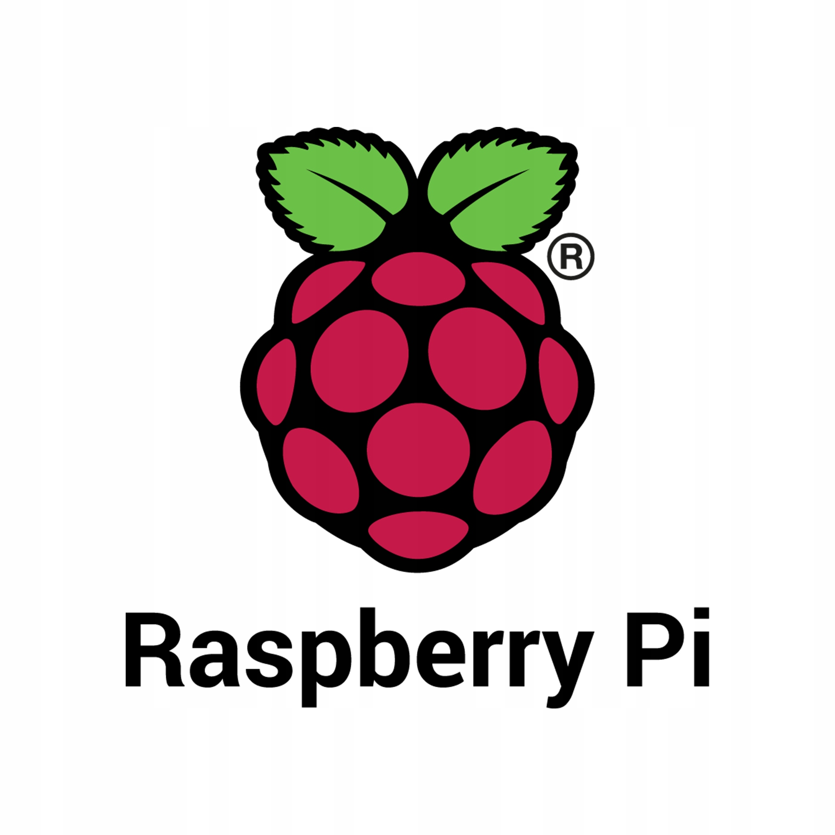
Thanks!

Slide 13
Questions?

